Slide 1




SEGMENTAREA TOPICA A DOCUMENTELOR TEXT
session, June 10th, 2022
Mihai FILIPOI
Workplace Lead
Alexandru HAGEA
Network and Security Lead

Slide 2
TOPIC
TOPIC
TOPIC
TOPIC
TOPIC
AGENDA
TOWN HALL

Slide 3
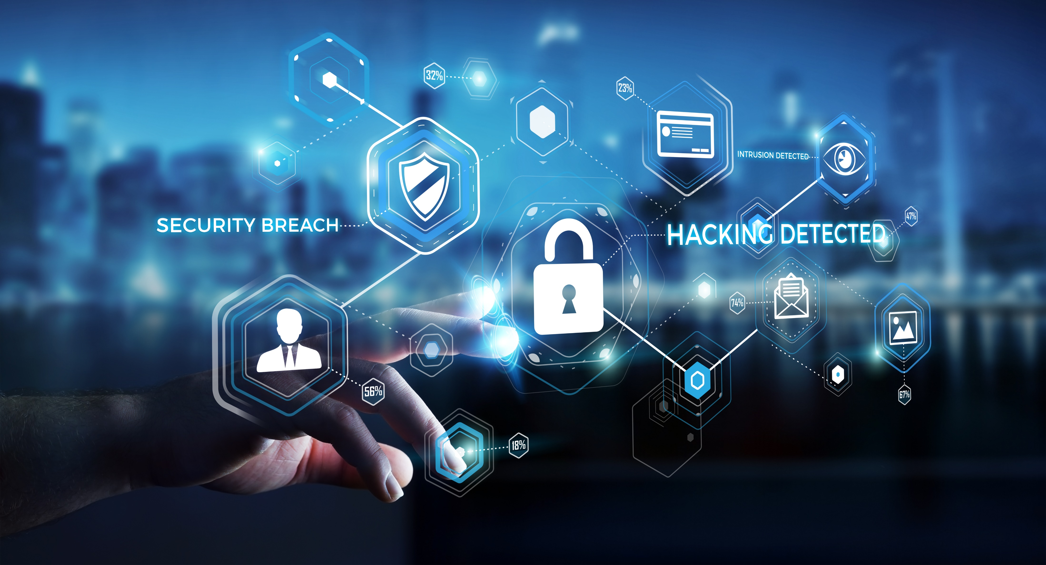
WHY DO WE NEED A SECURITY MINDSET?
Demo text
Demo text
Demo text
Demo text

Slide 4
2022 IT SECURITY IN 2022 NUMBERS
1
2
text
text
3
4
text
text
5
6
text
text

Slide 5



DEMO TEXT?
DEMO TEXT

Slide 6
WHAT IS ZERO TRUST AND WHY IS IT IMPORTANT?
Demo text demo text demo text. demo text. demo text. demo text. demo text. demo text. demo text. demo text. demo text. demo text. demo text. demo text. demo text. demo text. demo text. demo text. demo text. demo text.
Ubiquitous Least - Privilege Access
Notes:
Grant access but make it specific

Slide 7
THANK YOU

